Slide 1
Introduction to Embedded Systems
Dr.Sreejith Rajan

Slide 2
What’s an Embedded system
An embedded system is a computer system designed to perform a specific task or set of functions within a larger system.
Embedded systems are typically dedicated, resource-constrained, and optimised for efficiency, reliability, and real-time performance.

Slide 3
Don’t Forget these 4 things
What?
Where?
Why?
How?

Slide 4
History
1950s–1960s: The Precursor Era
Computers were giant, room-sized machines, built using vacuum tubes and later transistors.
Early embedded-like behavior was seen in military and aerospace applications, such as:
Apollo Guidance Computer (AGC) – developed by MIT for the NASA Apollo missions (1965).

Slide 5
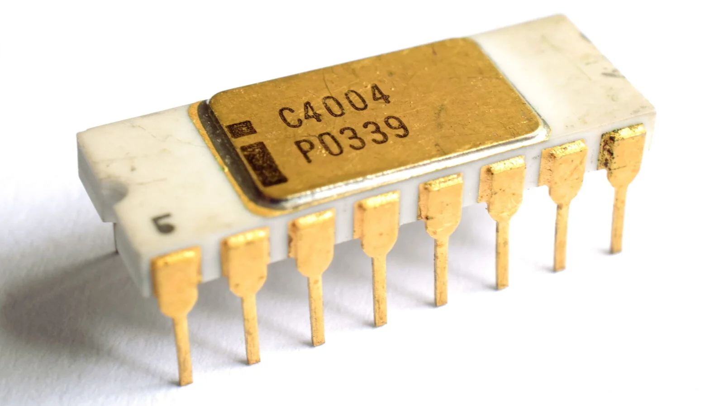
Birth of Microprocessor
Intel 4004 was launched – the first commercial microprocessor(1971).
4-bit CPU, originally designed for a calculator.
A major milestone that laid the foundation for embedding computers into everyday devices.

Slide 6
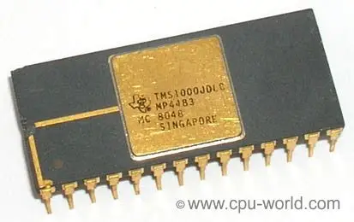
1974 Birth of microcontroller
The first microcontroller, TMS1000 (Texas Instruments, 1974)
CPU, RAM, ROM, and I/O on a single chip – a true embedded system-on-chip.

Slide 7
1980s -Rise of Microcontrollers
Explosion in 8-bit and 16-bit microcontrollers:
Intel 8051, Atmel AVR, PIC.
Development of real-time operating systems (RTOS)
VxWorks and QNX.
Firmware became an important layer
— code burned into ROM to control devices

Slide 8
90s – The connected Era
90s – Networked Embedded systems
Connected embedded systems
CAN, ETHERNET in automotive
TCP/IP in remote monitoring and diagnostics

Slide 9
2000s – Embedded meets Internet
IoT Foundations
Wireless sensor nodes, remote monitoring devices.
Smartphones as complex embedded platforms.
Emergence of Linux in embedded systems (OpenWRT, Android base).
ARM processors dominated low-power embedded design.

Slide 10
2010s – IoT and EDGE
Term "Internet of Things (IoT)" became mainstream.
Embedded systems became:
Smart (AI integration, local inference).
Connected (Wi-Fi, BLE, LoRa).
Miniaturized (wearables, smart tags).
Rise of Edge AI: on-device machine learning using TensorFlow Lite, TinyML.
Single-board computers (e.g., Raspberry Pi, BeagleBone) bridged hobby and industrial use.

Slide 11
2020s – Intelligent Embedded Systems
Embedded systems now power:
Self-driving cars
Wearable health tech
Drones and robotics
Industrial automation (Industry 4.0)
MicroPython, Rust, and other modern languages in embedded development.
Real-time ML models running on chips like ESP32, STM32, and NPUs.
Security and compliance (ISO 26262, IEC 61508) as critical requirements.

Slide 12
Microprocessors and Microcontrollers
Microprocessor (MPU): A general-purpose CPU (Central Processing Unit) integrated into a single chip, used for computation-heavy tasks.
Microcontroller (MCU): A compact integrated circuit designed to govern a specific operation in an embedded system. Includes CPU + memory + peripherals.

Slide 13
Comparison
Feature | Microprocessor | Microcontroller
CPU | Yes | Yes
RAM | External | Built-in
ROM/Flash | External | Built-in
I/O Ports | External | Built-in
Timers, ADC, etc. | Usually external | Built-in

Slide 14
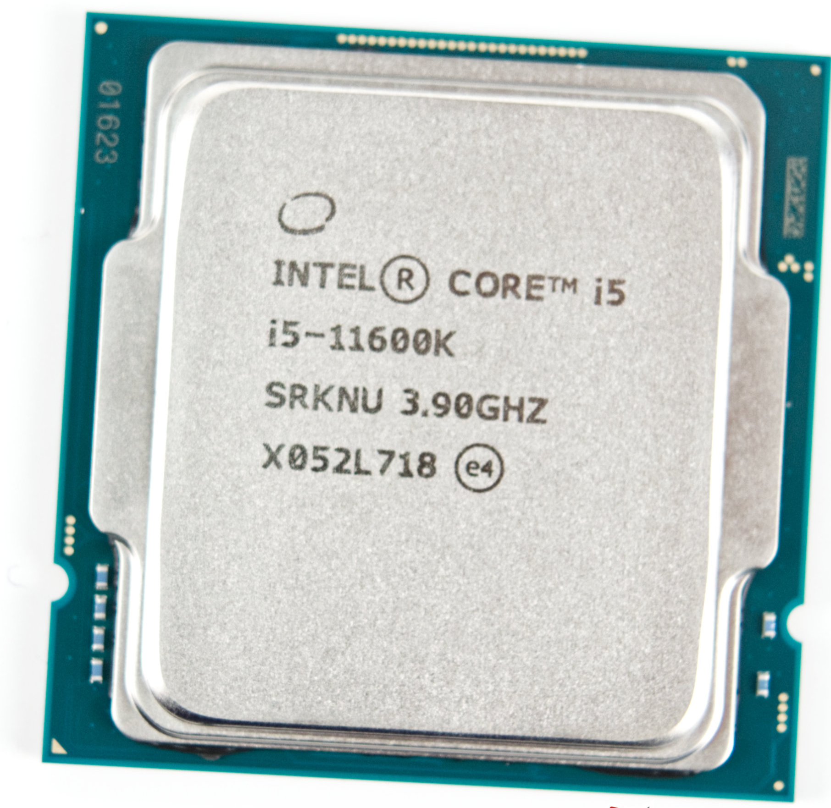
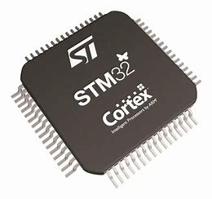
Photos

Slide 15
Applications
Microprocessor: Used in PCs, servers, smartphones — where complex computations and multitasking are needed.
Microcontroller: Used in embedded systems — washing machines, microwave ovens, IoT devices, automotive electronics

Slide 16
Power Consumption
MPU: Higher, since external components are required.
MCU: Lower, optimised for power-sensitive applications.

Slide 17
Cost
MPU: More expensive due to need for external RAM, ROM, I/O controllers.
MCU: Cheaper and more cost-efficient for single-purpose applications..

Slide 18
Performance
MPU: Faster (higher clock speeds), suitable for complex OS and applications.
MCU: Slower, but sufficient for control-oriented tasks.

Slide 19
Operating Syatem
MPU: Can run a full OS like Linux, Windows.
MCU: Usually runs bare-metal or lightweight RTOS (e.g., FreeRTOS).

Slide 20
Summary
Feature | Microprocessor | Microcontroller
Scope | General-purpose | Task-specific
Integration | Needs external peripherals | All-in-one chip
Power & Cost | High | Low
Ideal For | Desktops, smartphones | IoT, appliances, sensors

Slide 21
Development Board
A development board is like a ready-made circuit board that helps you build and test electronic ideas without designing the hardware from scratch.
Eg: Arduino, Nucleo Board, ESP 32, TI MSP Launchpad, Raspberry Pi etc

Slide 22
Dev Board
Component | Purpose
Microcontroller / Microprocessor | The brain of the board (e.g., ATmega328, STM32, ESP32)
Power Supply Circuit | Accepts USB, battery, or adapter input
GPIO Pins | Connect to LEDs, sensors, motors, etc.
Communication Ports | USB, UART, I2C, SPI for talking to other devices
Programming Interface | Load code via USB or serial
Onboard Components | LEDs, buttons, sensors (in some cases)

Slide 23
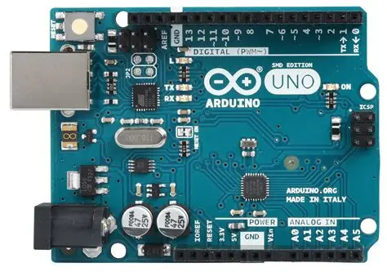
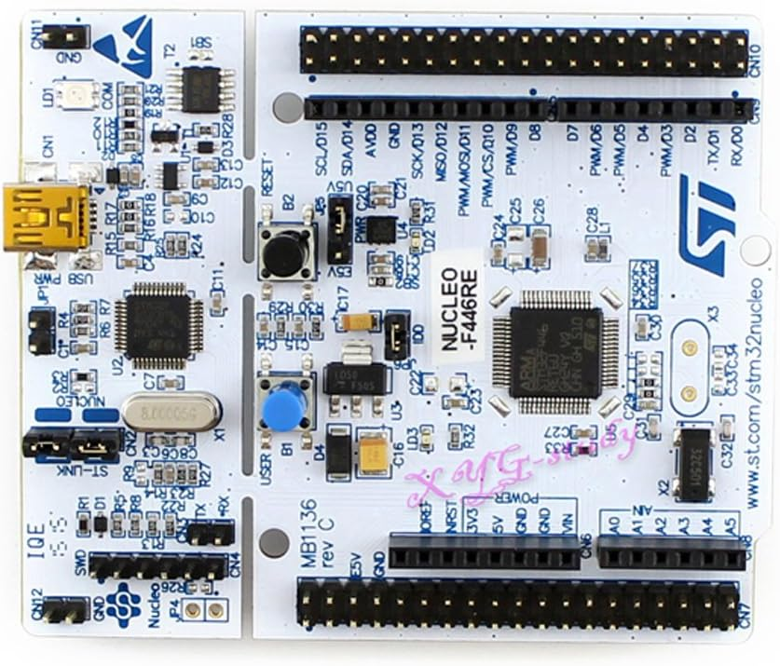
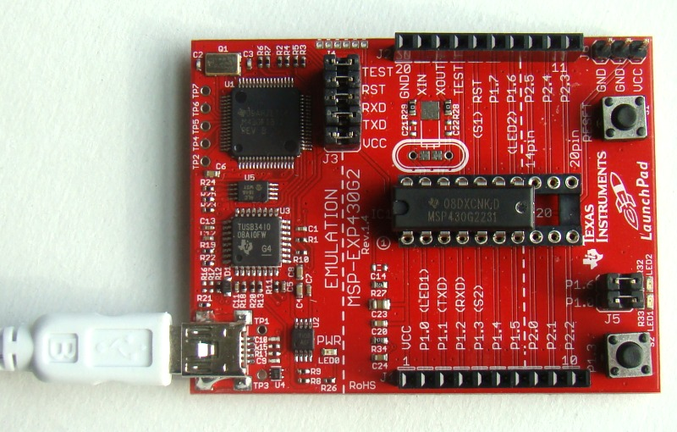
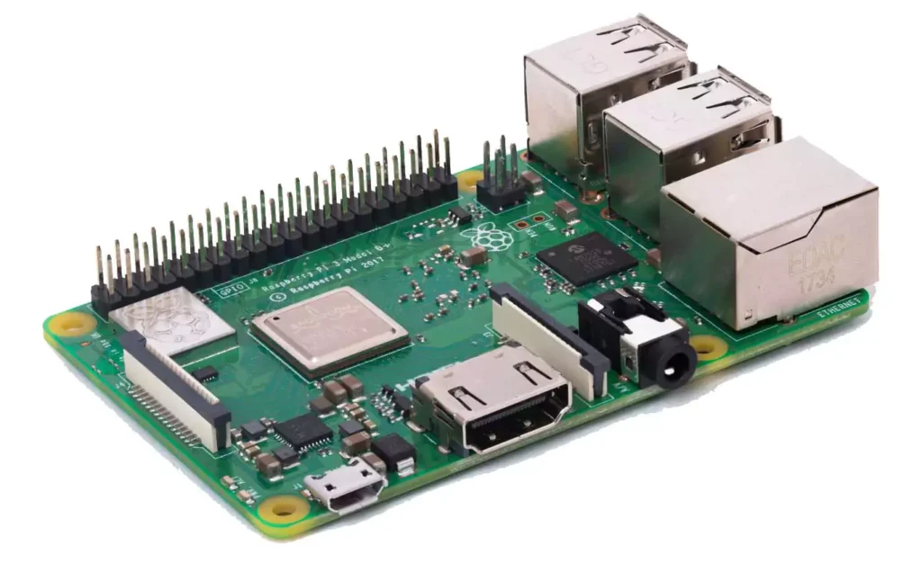
Some Boards

Slide 24
THANK YOU

